Slide 1
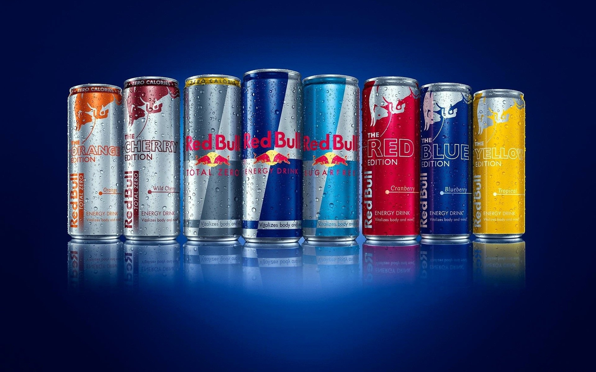
Analyzing Red Bull's Market Position through Customer Sentiment Analysis and Competitor Benchmarking
Team members:
Guy Gropper, Jofre Segarra, Tu Ho, Wojciech Dutkowiak

Slide 2
TABLE OF CONTENT
Business Goal Analysis
Problem Statement
Dataset Description
System Design and Implementation
Sentiment Analysis of Red Bull
Brand Comparison Analysis
Summary of Findings
Conclusion and Future Directions
Notes:
© Copyright Showeet.com – Free PowerPoint Templates

Slide 3
Business Goal Analysis
Objective: The goal of the project aims to analyze sentiment of Red Bull energy drinks and other brands based on Amazon's customers reviews to understand consumer needs, fostering product innovation and customer retention.
Goals:
Red Bull Sentiment Analysis:
Purpose: Analyze customer reviews of Red Bull over the most recent years from 2021 to 2024, to identify prevailing sentiments.
Outcome: Pinpoint major issues and areas for improvement based on product sentiment.
Market Analysis:
Purpose: Compare sentiment analysis of Red Bull with brands that has high popularity and consumption include Alani, Monster, and C4
Purpose: Perform a comparative sentiment analysis of customer reviews to identify strengths and weaknesses relative to Red Bull.
Outcome: Draw actionable business conclusions to enhance Red Bull's competitive edge in the market.

Slide 4
Problem Statement
How has sentiment of customers on Red Bull energy drinks changed over the past few years?
How is the consumer opinion on Red Bull’s product attributes compared to other brands?
In which aspects should Red Bull improve to ensure a positive customer experience?

Slide 5
Dataset description (1 of 2)
The dataset contains 500 reviews for each of the 4 energy drinks brands (Red Bull, Monster, Cellucor C4, Alani Nu)
Data was crawled from verified purchasers and sorted by most recent reviews
Reviews were categorized into positive (4-5 stars) and negative (1-3 stars)
The complete dataset include the following information: product name, date of review, review rating, review title, review text.

Slide 6
Dataset description (1 of 2)
Count of positive and negative class for each brand
382
118
317
183
200
300
198
300
Red Bull has the highest percentage of the positive reviews, then Monster, following by C4 and Alani with a similar number of positive reviews.

Slide 7
System Design and Implementation
Review Rating
Amazon
Red Bull Review Text
Text
Preprocessing
Output
Sentiment Analysis
Trend Analysis
Metadata
(Date, review title)
Extracted Features
Feature Set
Taste
Flavor
Price
Value
Output
Sentiment Analysis

Slide 8
Performance Evaluation (VADER)
Four approaches to sentiment analysis were employed for Red Bull's products, including: Bing Liu's Dictionary, LM Dictionary, TextBlob, and VADER. The VADER method, which showed the highest evaluation metrics, was chosen for the analysis of Red Bull and the other three brands.
 | RED BULL | MONSTER ENERGY | C4 | ALANI NU
Accuracy | 0.83 | 0.79 | 0.67 | 0.68
Precision | 0.84 | 0.79 | 0.76 | 0.78
Recall | 0.83 | 0.79 | 0.67 | 0.68
F1 Score | 0.83 | 0.78 | 0.66 | 0.67

Slide 9
Sentiment analysis of red bull
Notes:
© Copyright Showeet.com – Free PowerPoint Templates

Slide 10
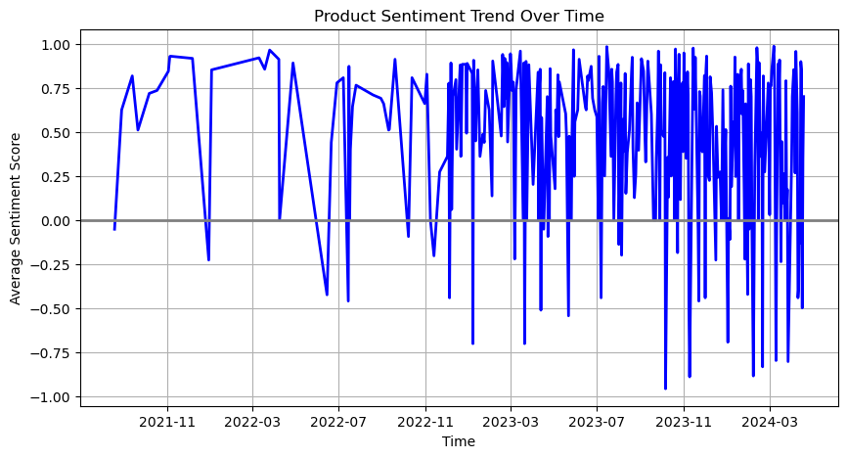
Overall sentiment analysis over time
Fluctuations in Sentiment: The graph shows substantial fluctuations in average sentiment score over time, with several sharp drops below zero, indicating periods where negative reviews significantly outweigh positive ones.
Negative Sentiment Peaks: From October to December 2023, and first quarter of 2024 the sentiment drops close to -1.0 may correspond to events or issues with the product that elicited strong negative feedback from consumers.
Overall Average Sentiment: Despite the volatility, the sentiment score seems to hover around the positive region (above 0) for several periods, indicating a generally favorable perception or experience associated with the product.
Critical Points for Action: The low points in sentiment offer critical opportunities for the company to engage in proactive customer service and product improvement initiatives.
Notes:
Sentiment analysis over year

Slide 11
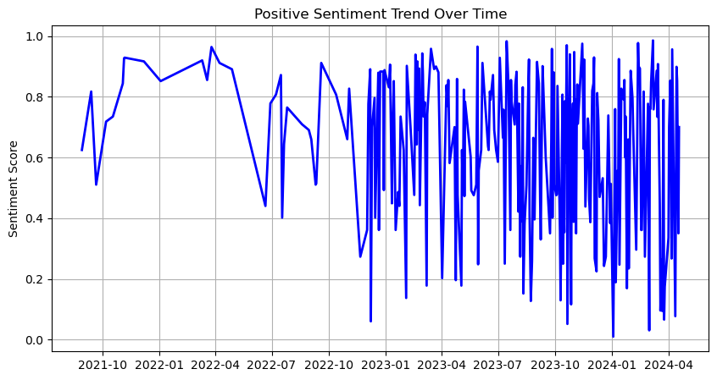
Positive reviews sentiment analysis over time
Volatility in Sentiment Scores: Notable volatility is observed in the sentiment scores with periodic drops in first quarter and December of 2023, several sentiment drops close to -1.0in January, March and April 2024, suggesting occasional surges in negative reviews or events that may impact consumer perception.
Positive Recovery Post-Dips: After each significant dip, the sentiment score tends to recover, implying effective response mechanisms to negative feedback or a resilient brand perception among consumers.
Future Analysis: The periods where sentiment scores decrease sharply requires further analysis to understand the causes and build strategies to mitigate these issues in the future
Notes:
Positive Sentiment analysis over year

Slide 12
The Majority of red bull purchases driven by brand appeal, taste and flavor
Most Frequent Keywords on Red Bull’s Positive Reviews
The primary factor that influence consumer’s purchase of Red Bull are brand appeal, followed by taste and price.
The most frequent positive comments on Red Bull refer to the brand name, which indicate strong preference for the brand during customer purchase journey.
Consumer also provide positive feedbacks on the taste and flavor of the brand, with keywords including ‘sugar free’, ‘taste great’ and ‘taste flavor’ appearing often.
Other key factors influencing consumer decisions include competitive pricing and attractive deals available on Amazon.
Keywords | Frequency
red bull | 166
energy drink | 57
sugar free | 38
great price | 22
taste great | 15
free red | 12
good price | 12
energy boost | 12
great deal | 11
best flavor | 11
Notes:
negative Sentiment analysis over year

Slide 13
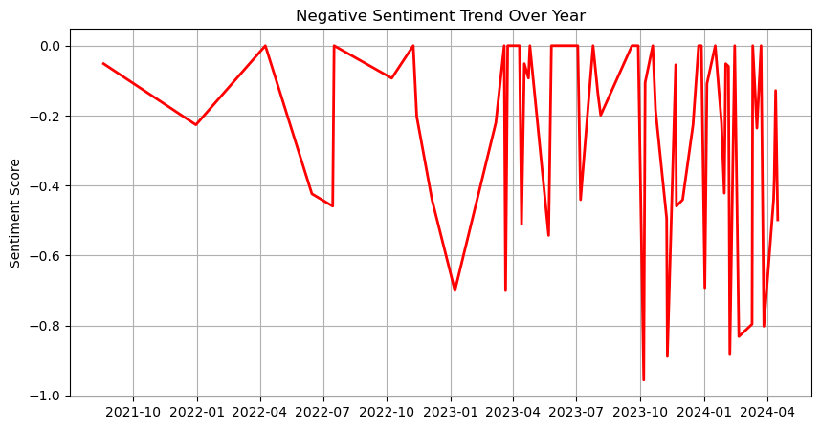
Negative reviews sentiment analysis over time
Indicating Issues: In October and December 2023, March to April 2024, the sentiment score dips closer to -1.0. This could be indicative of specific events or changes that were particularly poorly received by the customers. This dates requires further analysis.
Damage Control And Recovery: Every negative spike is followed by a sharp increase which indicates a low number of negative reviews. This implies good action taking decision by Red Bull to fix customers' complaints.
Inconsistency: The inconsistent spikes in negative reviews indicates an unstable level of service that must be tested and improved to increase overall customer satisfaction.
Periodic Review: These trends should be reviewed periodically to ensure ongoing management of customer satisfaction.
Notes:
negative Sentiment analysis over year

Slide 14
Top Complaint in Red Bull Reviews: Packaging Quality Raises Concerns About amazon’s Logistics
Most Frequent Keywords on Red Bull’s Negative Reviews
The top factor negatively affecting consumer purchase journey and leading to negative reviews of Red Bull is package quality.
Many purchasers reported issues include ‘can damaged’, ‘box broken’, ‘box damaged’ upon receiving their orders. While Red Bull may not directly handle shipping for products sold through mass merchandisers, addressing these logistical issues is crucial to ensuring a positive customer experience and maintaining a high retention rate.
Keywords | Frequency
can damaged | 7
damaged can | 5
give wing | 5
product came | 4
busted can | 4
can dented | 4
box broken | 4
box damaged | 3
two can | 3
shipping box | 3
Notes:
negative Sentiment analysis over year

Slide 15
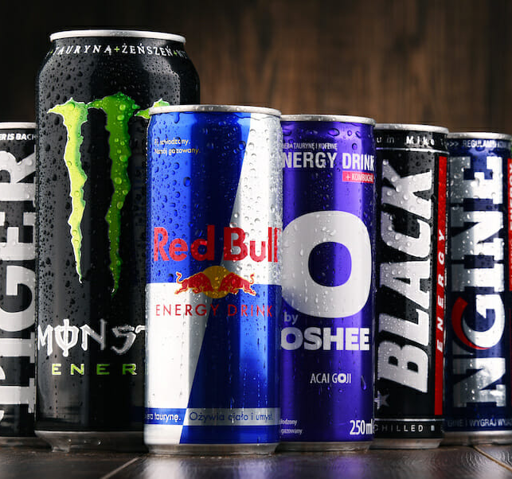
Brand comparison analysis
Notes:
© Copyright Showeet.com – Free PowerPoint Templates

Slide 16
Red Bull had the highest sentiment score among four brands in 2023, however, customer sentiment has slightly decreased in first quarter of 2024
Alani Nu is well-liked, with the customer sentiment not far behind big brand like Red Bull in 2023 and has been constantly increasing in Q1 2024; Monster’s sentiment score has also shown improvement in Q1 2024 compared to previous year.
Cellucor C4, despite being the least favorite brand in 2023, experienced a significant increase in sentiment score by 3.83 times in the Q1 2024, which is the most dramatic change among the brands.
Notes:
negative Sentiment analysis over year

Slide 17
Consumer emotion has been positive toward the product attributes of Red Bull, including taste, flavor, price, and value in 2023.
Red Bull sentiment score was strongest among four brands for flavor and price in 2023; customer opinions were particularly positive about Red Bull's flavor, being 1.4 times higher than for other brands.
In 2023, Alani Nu was the most-liked brand in terms of taste and value; consumer feedback on Alani's value was the most positive across the four brands.
Although a new brand, Alani Nu's taste was rated positively and received more positive reviews than big brands like Red Bull and Monster.

Slide 18
Although there has been a downward trend in consumer opinions of Red Bull’s product attributes in Q1 2024, the brand continues to maintain positive feedback on its product value
Red Bull has seen a decrease in consumer sentiment scores for taste, flavor, and price in Q1 2024; customer feedback on the brand’s taste and flavor has moderately decreased compared to the previous year.
Consumer opinion remains highly positive regarding the value of Red Bull products.
Cellucor C4 has experienced a surge in positive sentiment regarding their product’s taste, flavor, and value compared to last year; with the most significant increase observed in consumer sentiment towards their value.

Slide 19
Summary of findings
Red Bull's Sentiment Dip: Red Bull experienced a decline in customer sentiment in the first quarter of 2024, despite leading in sentiment score in 2023.
Alani Nu's Rising Popularity: Alani Nu has shown a steady increase in sentiment, closely trailing Red Bull and leading in the taste and value metrics in 2023.
Monster's Gradual Improvement: Monster Energy has demonstrated an improvement in sentiment in Q1 2024, indicating a growing customer approval.
C4's Significant Leap: Cellucor C4, while the least favored in 2023, saw the most dramatic sentiment increase in Q1 2024, potentially creating a turnaround in customer perception.
Flavor and Price Concerns for Red Bull: There is a noted decrease in sentiment for Red Bull's flavor and price, but it continues to maintain strong positive feedback on product value.
Consumer Insights on Value: Across all brands, consumer sentiment on value remains a strong point, with Cellucor C4 showing remarkable improvement in this aspect.

Slide 20
conclusion and future directions
Maintain Product Value: Red Bull should continue to emphasize and enhance the value of product as customer sentiment remains strong in this area.
Address Flavor and Price Concerns: Since there is a decrease in sentiment for Red Bull's flavor and price, these aspects may need reevaluation or improvements to align with consumer expectations.
Reinforce Strengths: Red Bull still leads in overall sentiment from the previous year, so maintaining their current strengths is crucial. Additionally, a continuous effort to develop the flavors and packaging of new products is important for sustaining positive consumer feedback and consumption.
Innovation and Adaptation: Given the shift in customer sentiment, innovation in product development could be a strategy to rejuvenate interest in taste and flavor. Adapting to consumer demand and lifestyle trends is critical for understanding consumer preferences, as health has become a focal point nowadays.
Marketing Strategy Review: Red Bull may need to review and possibly adjust marketing strategies to better communicate the product's strengths and address any negative perceptions.
Engagement and Feedback: Increasing engagement with consumers to gather more direct feedback could provide insights for targeted improvements. Further analysis of the product's negative reviews may be instrumental in enhancing consumer experience, which can lead to a higher retention rate.

Slide 21
Project limitation
Limited Review Volume: The analyzed data comprises only 500 reviews per brand, which may not capture the full spectrum of customer sentiment.
Demographic Data Unavailability: Lack of demographic information on reviewers limits insights into varied consumer experiences and preferences.
Customer Segmentation Lack: The absence of customer segmentation data prevents a deeper analysis of distinct consumer groups.
Date-Correlated Analysis: Further investigation is required into the dates of negative reviews to pinpoint external factors influencing customer dissatisfaction. Some issues can be related to Amazon's service.

Slide 22
Q&A
Thank You!

